Slide 1


StateRAMP Overview for Service Providers
Notes:
Good Afternoon, We are so happy to have you attend today’s webinar. We will be starting shortly.
Good Afternoon, my name is Stacey Carswell and I am the government engagement manager for StateRAMP. We are here to today to talk about the StateRAMP program and what it could mean for you.
I am joined by my esteemed colleagues Mattie Gullixson and _______________ who will now introduce themselves. Mattie?
Thank you (both) for your introductions. Let’s begin!

Slide 2
Table of Contents
What is StateRAMP?
How Does StateRAMP Work?
How Do I Get Started?
What is Happening in New Hampshire?

Slide 3
Purpose
Ensure Understanding of Updated Cybersecurity Requirements
Share StateRAMP process
Share resources & points of contact for ongoing support

Slide 4
What is StateRAMP?

Slide 5

StateRAMP is a registered 501(c)(6) nonprofit membership organization that serves governments by providing a simplified and standardized approach for validating the cybersecurity of the service providers that process, transmit, and/or store any government data as part of their contract, including PII, PCI, and PHI.
Our mission is to promote cybersecurity best practices through education, advocacy, and policy development to support its members and improve the cyber posture of state and local governments and the citizens they serve.
This standardized approach allows providers serving state and local governments to verify their security posture and prove their cybersecurity compliance to their government clients.
Learn more at www.stateramp.org
Notes:
SLED – state, local, education and tribal or SLTT organizations
StateRAMP – Ramp being Risk Authorization Management Program

Slide 6
StateR(isk) A(uthorization) M(anagement) P(rogram)
  State and local governments are under attack.
  Self-attestation check box for cybersecurity compliance is not sufficient any longer for state and local governments.
  To better manage third party risk, state and local governments want proof of compliance.
  StateRAMP provides centralized and standardized validation and continuous monitoring of security to verify once and serve many.
  Rather than provide documentation to 50 states and countless local governments, vendors can provide validation of compliance through one secure portal with StateRAMP.
  Outcomes: standardized approach, consistency in solicitations, fewer one-off procurement requirements, reduced friction in contracting, and improved security for providers, governments and those they serve.
Notes:
As the cyberworld evolves, so must we. As more data breaches occur across both the public and private sectors, self attestation is no longer sufficient. Proof of compliance will be needed as we work toward managing third party risk. With StateRAMP, that proof of compliance will only result in one program as we continue to grow across the 50 states.

Slide 7
StateRAMP: Addressing Cybersecurity Upstream
The goal is to create a framework for continuous improvement in cybersecurity for state & local governments, providers, and the constituents they serve.
Shared Services Model for SLED
“Verify Once, Use Many” Approach for Providers
Centralized Resources for SLED & Providers
Path for Procurement to Verify Controls Required
Ongoing Commitment to Education & Best Practices
Government-Led Governance & Collaboration
Risk and Authorization Management Program (RAMP)
Notes:
Verify Once, Use Many meaning that once your product is StateRamp Verified, you can use it satisfy requirements with our participating governments

Slide 8
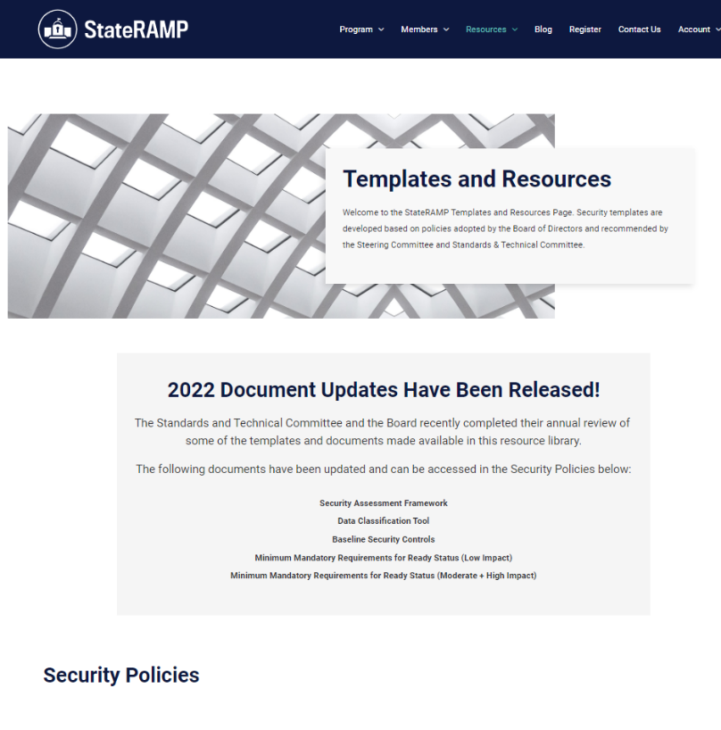
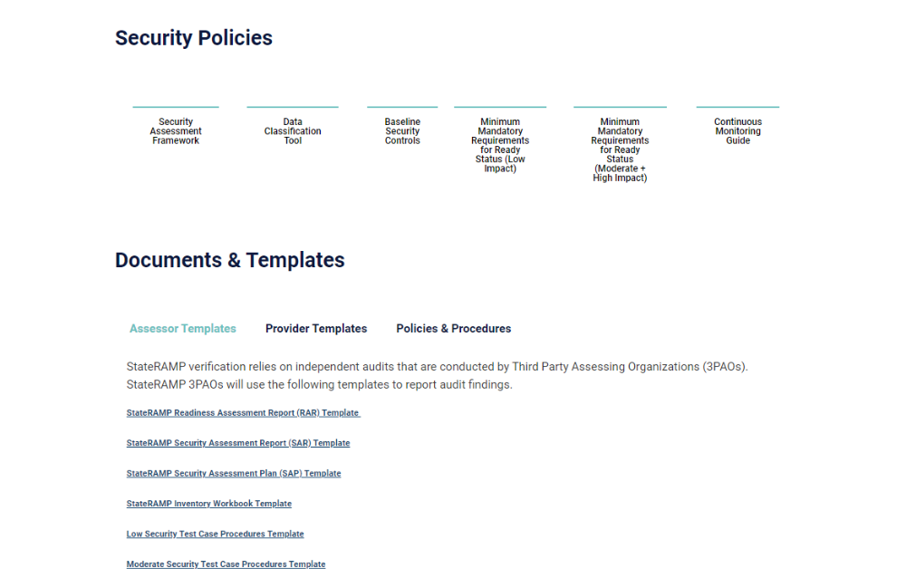
Security Framework
Governance committees adopt policies that define:
  Baseline minimums standards
  Process for StateRAMP verification
StateRAMP baseline requirements built on NIST 800-53 Rev. 4
  Transition to Rev. 5 in 2023/2024
  Goal to map to other regulatory frameworks
    CJIS, MARSE/MMIS/HIPAA and more
  StateRAMP process and policies built on NIST 800-161
Find policies, templates and resources online
  www.stateramp.org/templates-resources

Slide 9
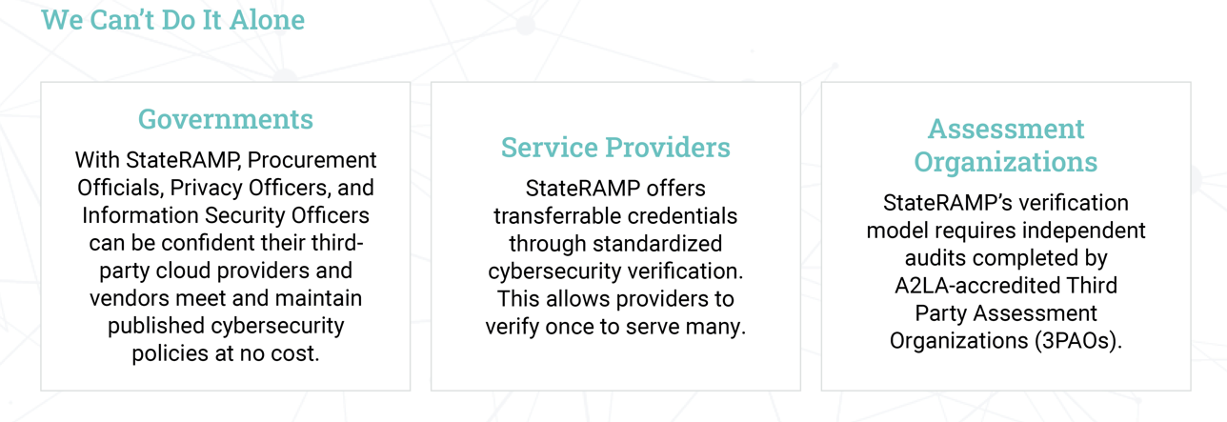
StateRAMP Members
Notes:
3PAO StateRAMP’s verification model for a verified status requires independent audits…now we’ll talk about How the program works.

Slide 10
How Does StateRAMP Work?

Slide 11
Terminology
Service Provider
Provider who utilizes IaaS, PaaS and/or SaaS to process, store and/or transmit data
3PAO
Third Party Assessment Organizations
Conducts audits and assessments
30+ accredited by FedRAMP
Security Packages
Documentation of a cloud system’s security
Impact Levels
Based on sensitivity of data and criticality of system
Aligned with FedRAMP and NIST 800-53 Rev. 4
Security Status
Status of security authorization
Milestone statuses: Ready, Provisional and Authorized
PMO
Program Management Office
Reviews 3PAO audits and recommends security status based on board-adopted policies
Authorized Product List (APL)
Directory of providers’ offerings with StateRAMP Security Status
Fast track process for FedRAMP approved offerings

Slide 12
StateRAMP Overview
Pre-Ready
StateRAMP Security Snapshot
Progressing StateRAMP Security Snapshot
StateRAMP Ready
StateRAMP Authorized
StateRAMP Security Snapshot is not required to obtain StateRAMP Ready or Authorized status
StateRAMP Security Snapshot Progressing Reporting is not required by StateRAMP. Requirement determined by Participating Government.
StateRAMP Ready is not required to achieve StateRAMP Authorized status

Slide 13
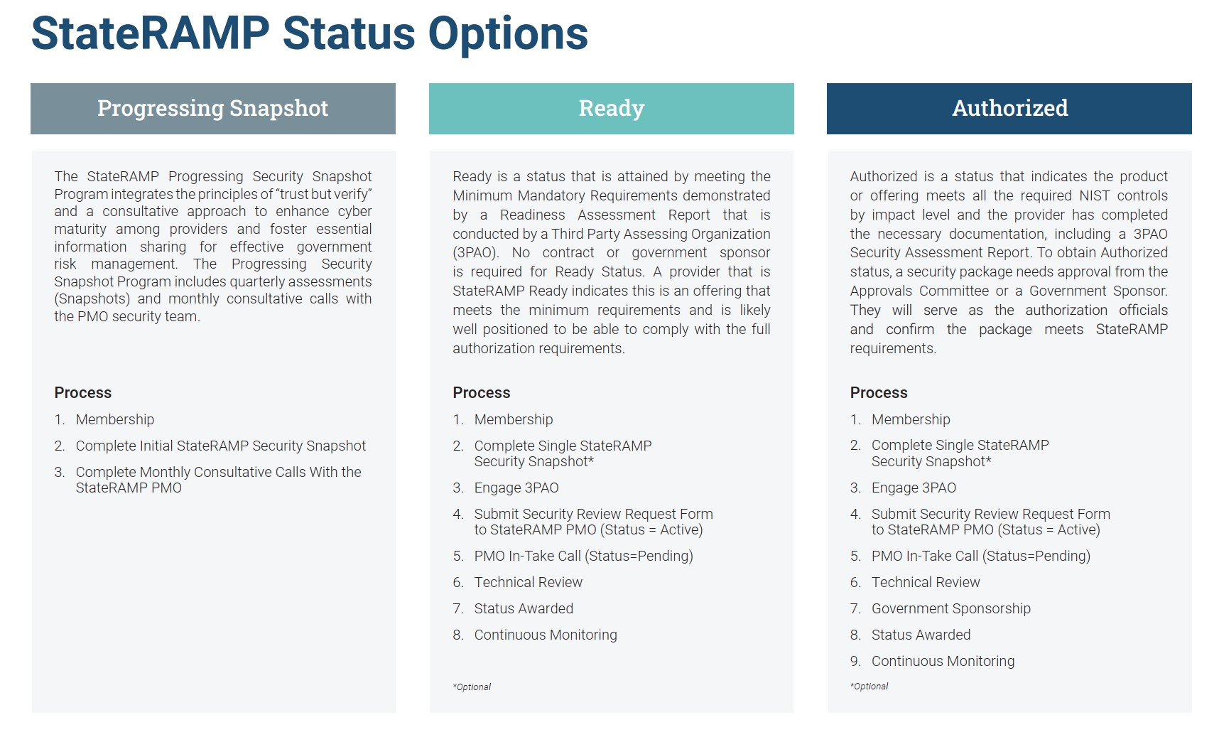

Slide 14
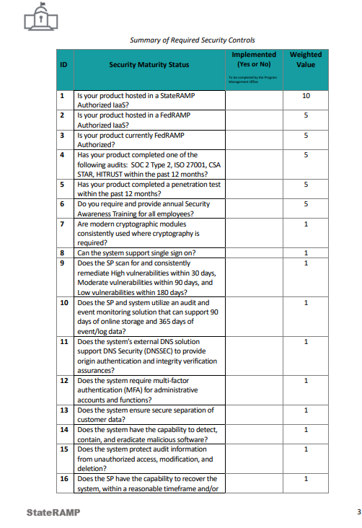
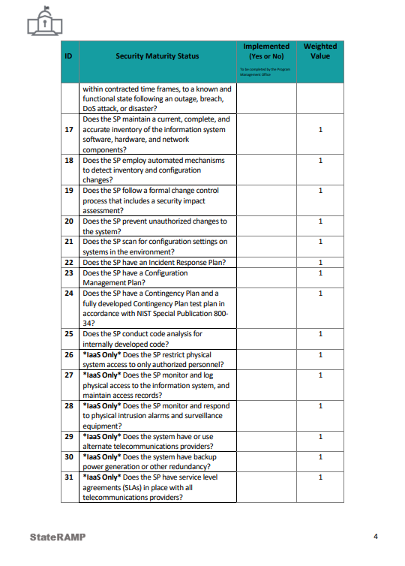
StateRAMP Security Snapshot
Gap assessment & score
Independent verification & validation by StateRAMP PMO
NIST 800-53 most critical controls
Delivered within 3 weeks (complete request)
Can share with government customers
$1,500 (reduced fees for small businesses)
Request Snapshot at www.stateramp.org

Slide 15

Progressing Security Snapshot Program
Combines 'trust but verify' principles and a consultative approach to improve cyber maturity for providers and begin information sharing critical to effective risk management for government.
StateRAMP Security Snapshot
Monthly Consultative Progress Calls

Slide 16

Progressing Program Enrollment
Quarterly Snapshot Updates
Monthly consultative calls with PMO Security Team
Providers may provision access for government clients to view Snapshots and Progressing Notes
$1,000 monthly subscription (reduced fees for small businesses)
Speak with our Team to enroll at info@stateramp.org

Slide 17
StateRAMP Impact Levels
Not every contract requires StateRAMP authorization. The key to determining where it applies is around the type of data the vendor processes, transmits, or stores.
State agencies will use the following data classification tool to assess whether it is required.
StateRAMP has defined the following Impact Level Categories that align to NIST 800-53 Rev. 4
Low
*Low +
Moderate
High
StateRAMP Low Control Baselines
StateRAMP Low + Select Moderate Controls
StateRAMP Moderate Control Baselines
FedRAMP High Control Baselines
Notes:
For those unfamiliar with NIST, it stands for the National Institute of Standards and Technology, out of the U.S. Dept of Commerce. They developed a cybersecurity framework that has become the primary standard for the public and private sector to understand, manage and reduce their cyber risk and protect their networks and data.

Slide 18
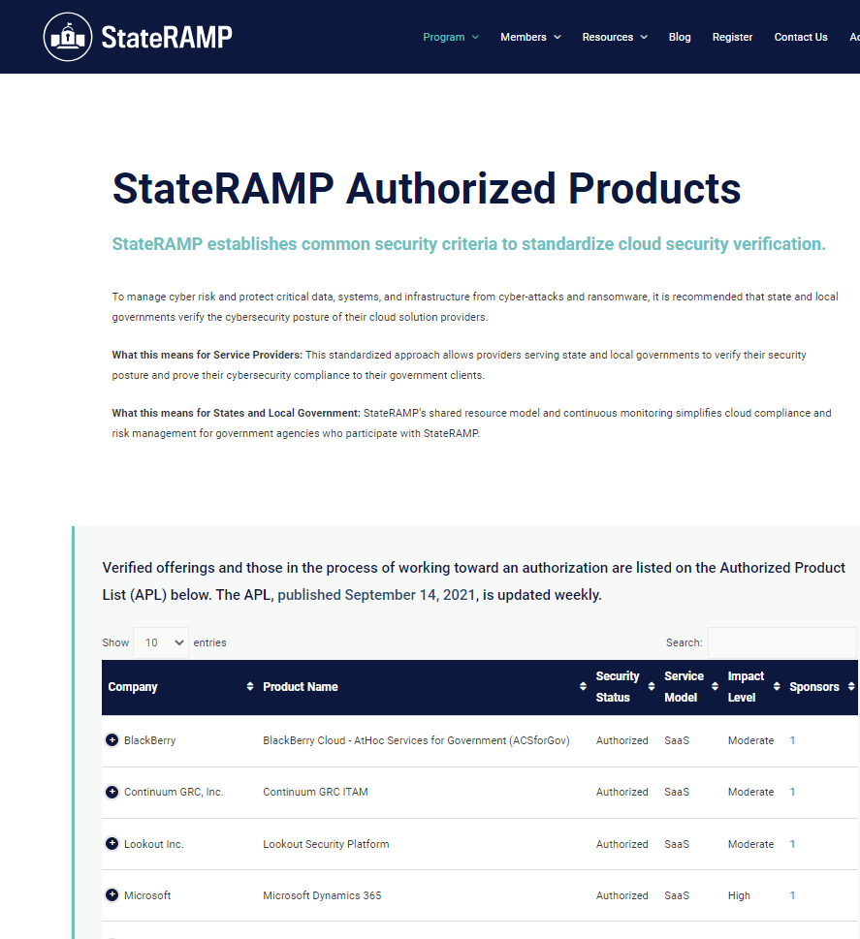
Authorized Product List
Public list on www.stateramp.org
Recognize progressing and verified statuses
Continuous monitoring is required to maintain a verified listing (Ready, Authorized, and Provisional)
Participating StateRAMP Governments provided secure access to portal to view continuous monitoring
Notes:
Leah

Slide 19

Continuous Monitoring
Providers must comply with Continuous Monitoring requirements to maintain status of Ready, Authorization or Provisional
Monthly vulnerability reporting from Provider to PMO
Quarterly POA&M Update from Provider to PMO
*Annual Audit by 3PAO submitted to PMO
Monthly reporting from PMO to State
Notes:
PORTAL – discuss that only individuals who should have access will be allowed access and that the vendor will have veto power on access to ensure the height of confidentiality.
POAM – Plan of Action and Milestones

Slide 20
StateRAMP: Trust but Verify – Ready & Authorized
Public Agency Requires Standards
Vendor Engages StateRAMP
Product has Independent Audit
StateRAMP Verifies Requirements Met & Assigns Status
StateRAMP Manages Continuous Monitoring
Public Agency Makes Risk-Based Decisions
Verify Cloud Products Used by Public Agencies Meet Minimum Security Requirements Ongoing
    Standardized Requirements (Based on NIST 800-53)
    Independent Annual Audits
    Centralized Program Management Office (PMO)
    Continuous Reporting & Validation (Monthly & Annual)
    Shared Service for Government
    Verify Once to Serve Many for Vendors

Slide 21
How Do I Get Started?

Slide 22
Join the Mission
Become a Member at www.stateramp.org/register
  Connect with a Membership Engagement Specialist at info@stateramp.org
  Membership Benefits
Have a Voice
Nominate for Committee
Provider Leadership Council
Access StateRAMP Program
Improve Nation’s Security!
Education & Resources
Notes:
You can be nominated as either a member and/or advisor for some our committees, including the Steering Committee, Appeals Committee, Standards & Technical Committee and of course our Provider Leadership Council.

Slide 23
What is Happening in New Hampshire?

Slide 24

New Hampshire Adoption
New Hampshire is committed to starting a phased rollout of StateRAMP for new IT-related contracts beginning soon.
Additional detail will be forthcoming on specific rollout dates and processes.

Slide 25

New Hampshire Program Page
New Hampshire and StateRAMP External Page
Public Facing Page on StateRAMP website
Communications
  Announcements
  Document Library
  Training Library
  Points of Contact
  StateRAMP Requirements
  Links to Resources
Notes:
Insert picture of finalized external page

Slide 26
Questions?
Email info@stateramp.org
Thank you.
Notes:
Now we will open the floor for questions. Feel free to either unmute yourself or use the chat feature.
Well thank you everyone for your time. Become a Member at www.stateramp.org/register and you can Connect with a Membership Engagement Specialist at info@stateramp.org

